Slide 1
Product Recommendation Model
By Xiaoting (A20503290), Bo (A20524770), Nevil (A20474215)
Goal :
Analyze data to find out the entities and items with the highest frequency and identify association rules of items that always appear together in the target period, build a model to predict which items are most popular on past transaction history, and recommend them to customers in the future to increase store revenue.
Notes:
May
Here is the outline of today’s presentation.
First,
Especially, I would like to highlight the key motivation of our project.
Then, our group member will go deeper into the data and model.
Finally, I will talk about the future work and we will answer the questions.

Slide 2
Content
Project Introduction (May)
Data Description (Bo)
Data Analysis (Bo)
Data Modeling (JD)
Model selection and Analysis
Association Analysis
Model to Predict Next Week, Month (JD)
Conclusion and Future Work (May)
References (May)
Notes:
May
Here is the content today.
The name at the end of each content will give the introduction and explanation.

Slide 3
Project Introduction - motivation
Instacart is an online grocery delivery and pick-up service provided by an American Company.
Instacart offers its services via a website and mobile app
We aim to build a model that predicts which items will be the best seller in the future target period
This can boost sales for the company by forecasting merchandise sales trends, adjusting stocks in time, and suggesting popular products to consumers, which increases sales.
Notes:
May

Slide 4
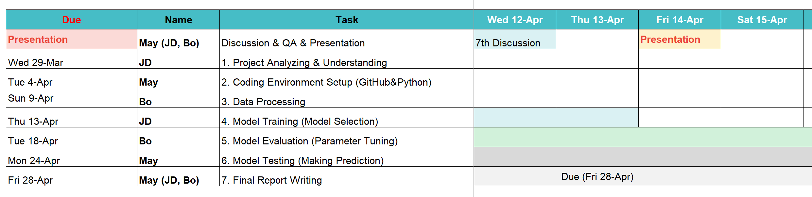
Project Introduction – Group Member & Tasks
Weekly group discussion to check the project progress
Notes:
May

Slide 5
Data Description
Data is extracted from the Kaggle
There are five relational groups of files that track the orders that customers place over time.
Each user receives between 4 and 100 of their order details, including the order of the things they purchased in each order, the day and week it was placed, and the amount of time between orders.
Each entity (customer, product, order, aisle, etc.) has an associated unique id and its related data.

Slide 6
Data Description
Aisles: This file contains different aisles and there are a total of 134 unique aisles
Departments: This file contains different departments and there are a total of 21 unique departments
Orders: This file contains all the orders made by different users.
Products: This file contains the list of a total of 49688 products and their aisle as well as department
Prior: This file gives information about which products were ordered and in which order they were added to the basket. It also tells us that if the product was reordered or not

Slide 7
Data Processing
Data Processing is important in further Analysis
After analyzing the initial dataset, we converted various character variables to Factors and numeric values to numeric
The factor conversion is done on orders, products, aisles, and department data sets

Slide 8
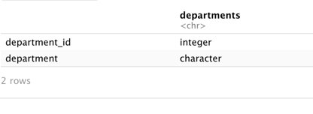
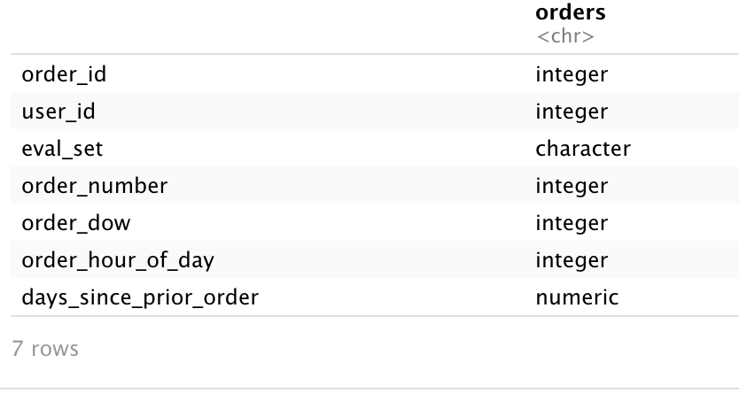
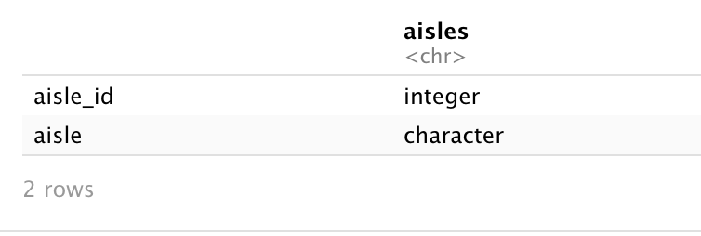
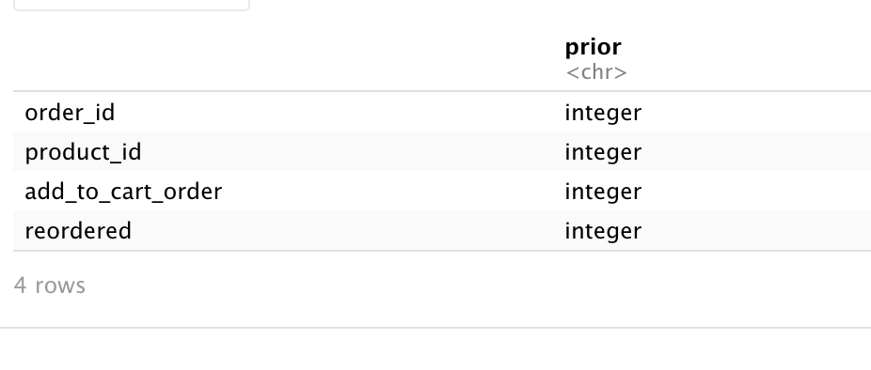
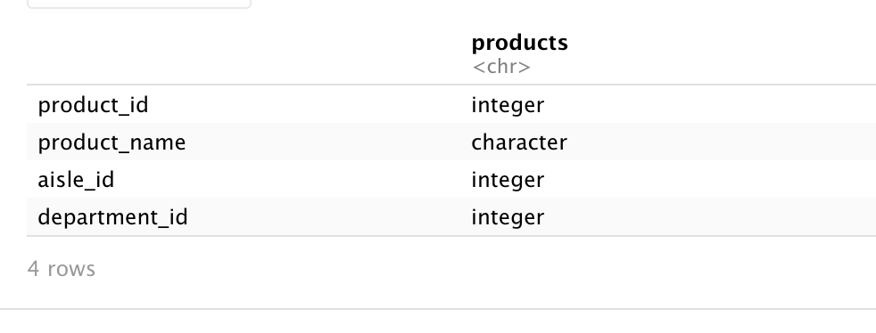
Transformed Data set

Slide 9
Data Analysis
We merged datasets of products, Aisles, and Departments data to find the exact product offerings.
The Merged products, Aisles, and Departments data have 49688 Rows and 6 Columns.
We further explore the data to find the product offerings of Instacart data.

Slide 10
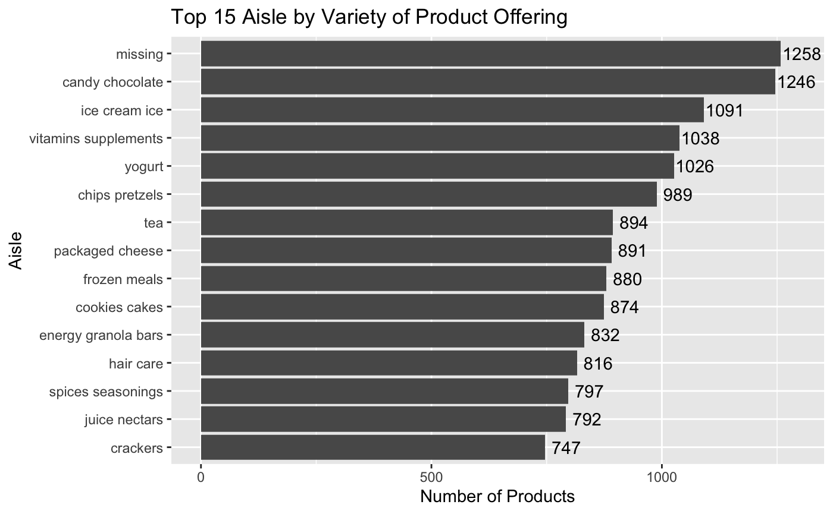
Aisle by Variety of Product Offering
The graph shows that most customers order and purchase products like crackers, juice nectars, etc., This shows the preference of the customers.​
Also, there are some missing items in the aisle which mean we don’t know where the product is located or the product_id does not match the aisle_id

Slide 11
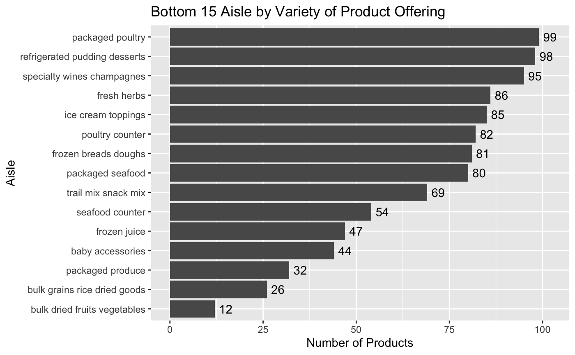
Aisle by Variety of Product Offering
Graphs show that bulk products like dried fruits, vegetables, and dried grain rice are most ordered and purchased than wines and poultry products.
Also, there are no missing items in the aisle which mean no item is mismatched in this set of data.

Slide 12
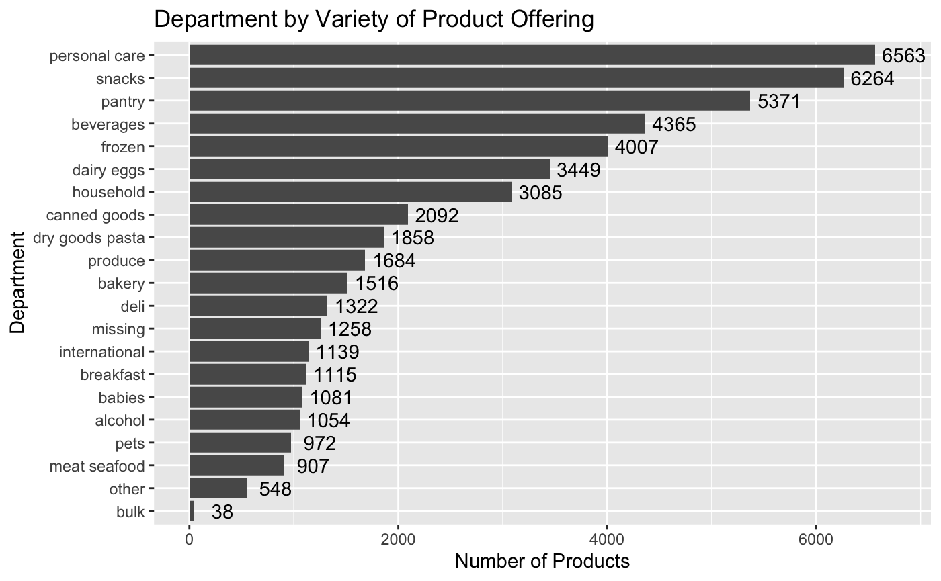
Department by Variety of Product Offering
The graph shows popular departments which are very close to each other
The departments that are in bulk are ordered and purchased most by the customers.

Slide 13
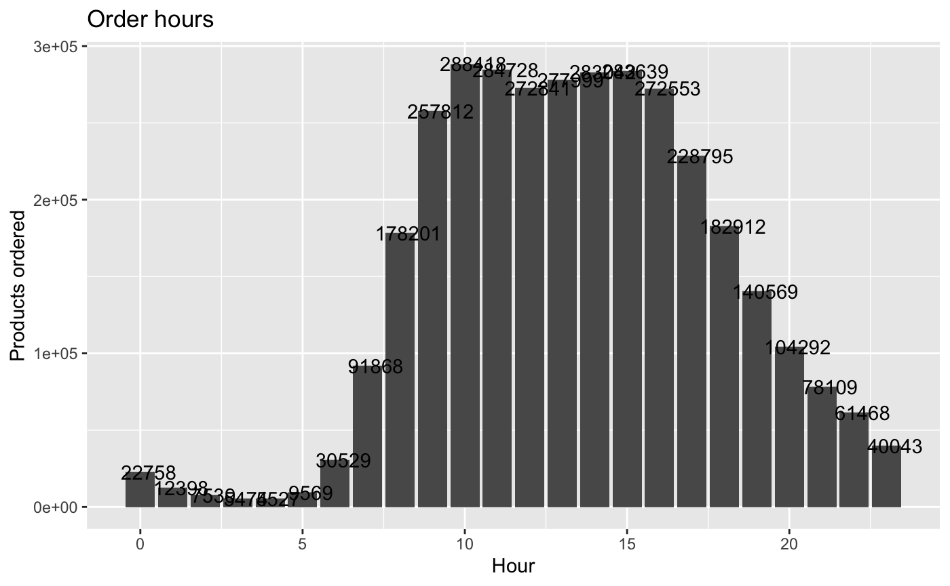
Orders by hour
The plot shows that for the first 5 to 6 hours the number of products ordered is very less.
The products ordered between 7 to 20 hours are more and then decreases after 20 hours.
This explains that the middle of the day is more active than the opening and closing hours.

Slide 14
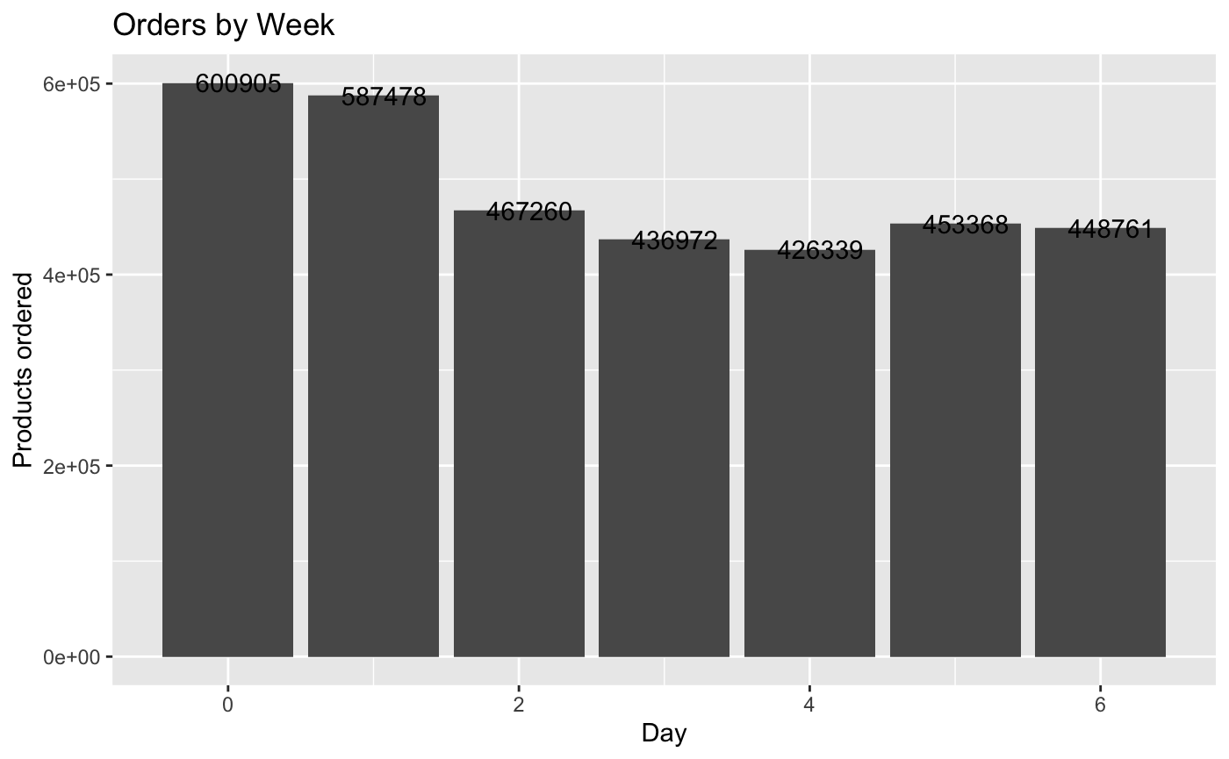
Order by week
The graph clearly states that in the
Start of the week the product orders are high and by the mid of the week the ordering decreases and gets stable by the end of the week.

Slide 15
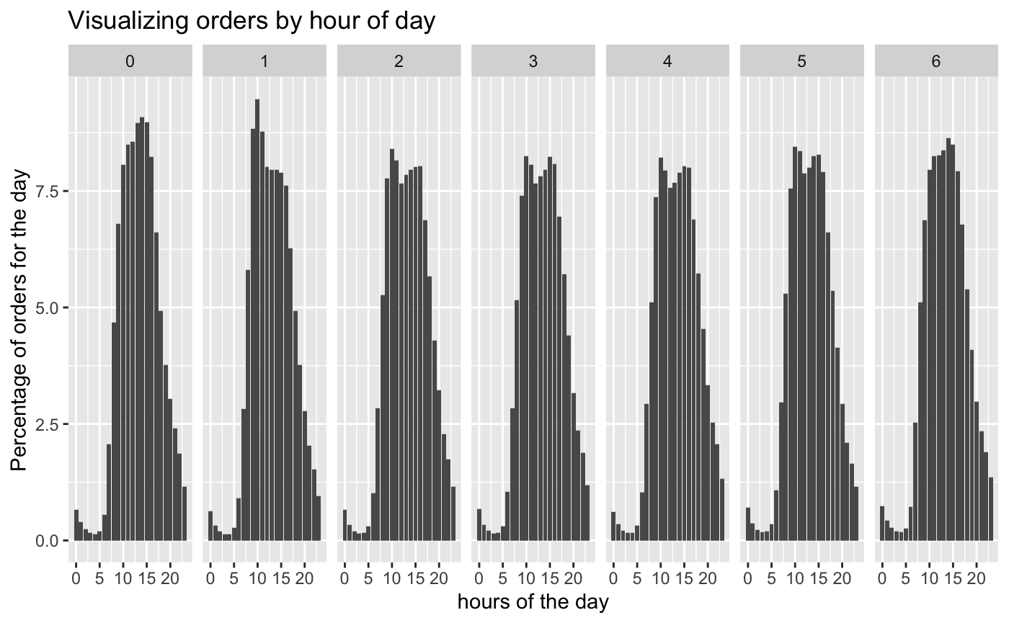
Orders by Every day Every hour
The Graph shows the product order percentage vs hours in a day.
Every hour has a different order patten.
The percentage of products ordered by the middle of the hour reaches a maximum at every hour.
By this, we can analyze the peak ordering time in an hour.

Slide 16
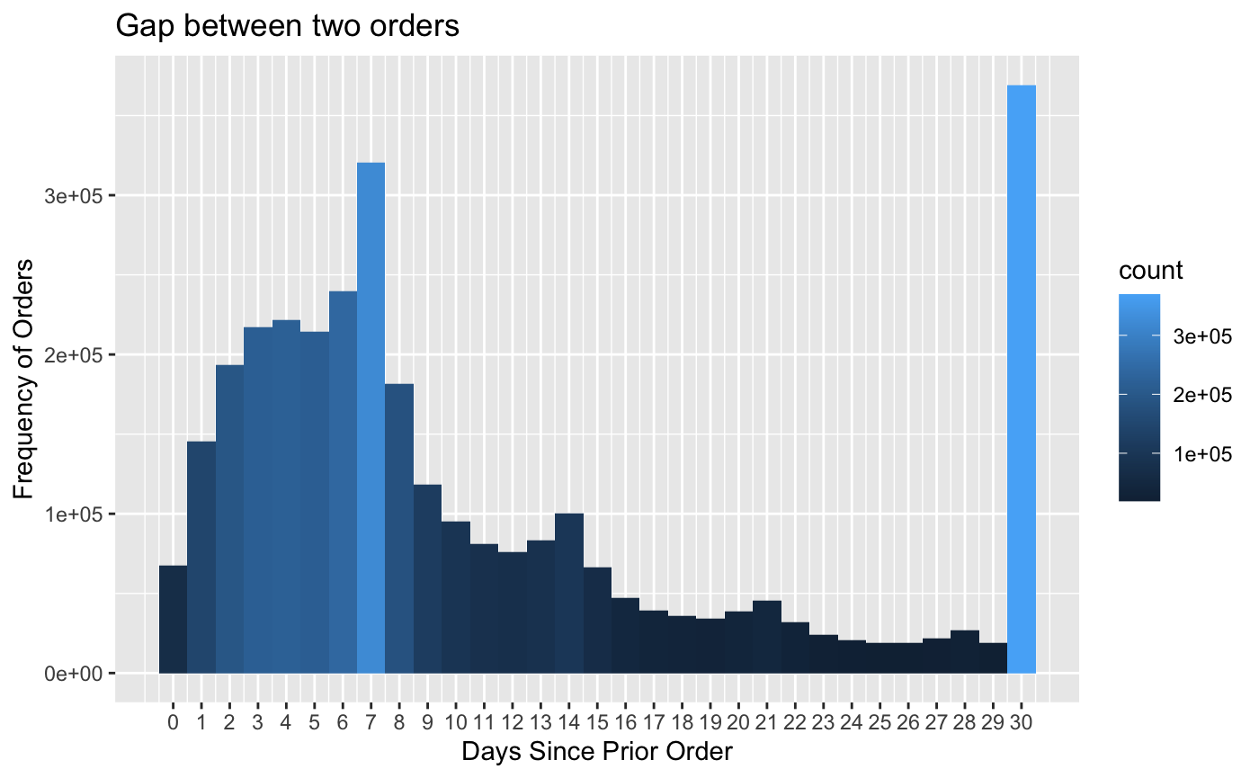
Days Since Prior Order Analysis
Based on 30th day and 7th day peaks. People reorder on average 11% monthly and 9% weekly.
This demonstrates that some people restock their food every month and others restock them weekly.
The frequency of NA denotes the total number of distinct users and their initial order.
There is a continuous spike in orders from day 1 to day 6, which shows that some people are frequent buyers with a short window of restocking.

Slide 17
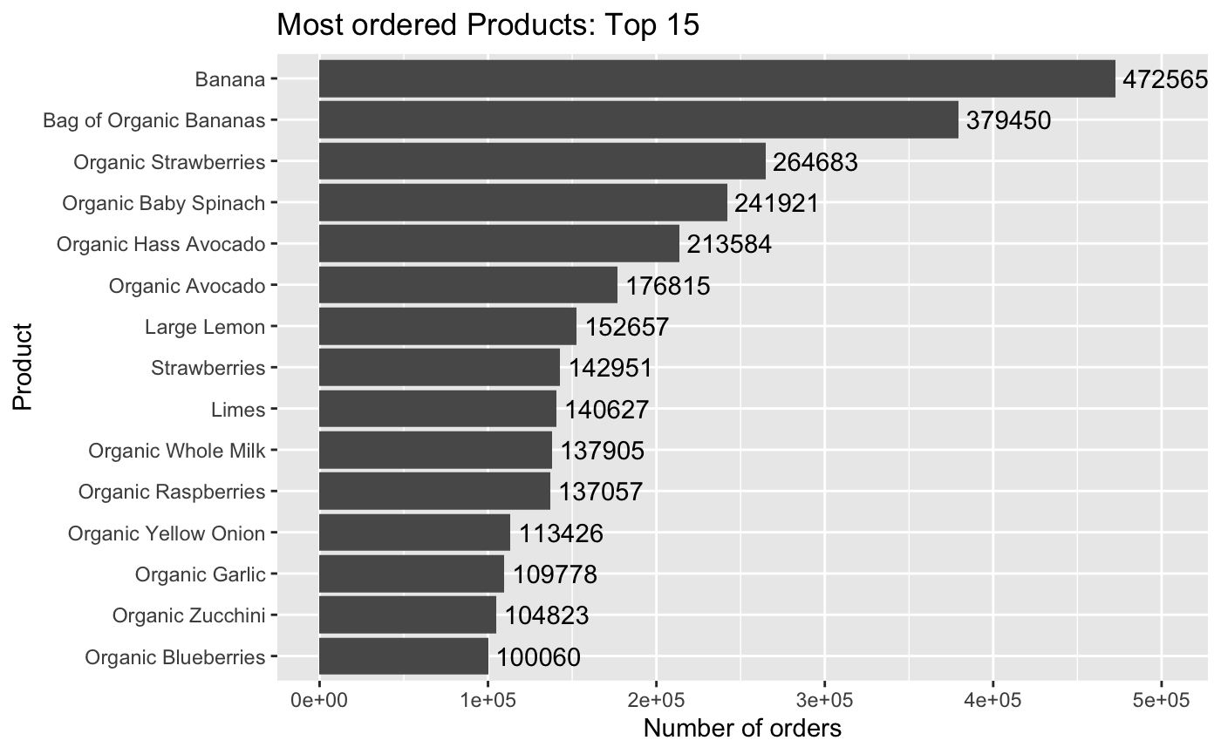
Prior Table Analysis
We can predict their next purchase or order by looking the history of their order using prior table. ​
From the graph, we can see the result that the most ordered product is Banana and Organic Banana which tops in the top 15 products.
The graph represents the history of orders by all the users and their most preferred product.

Slide 18
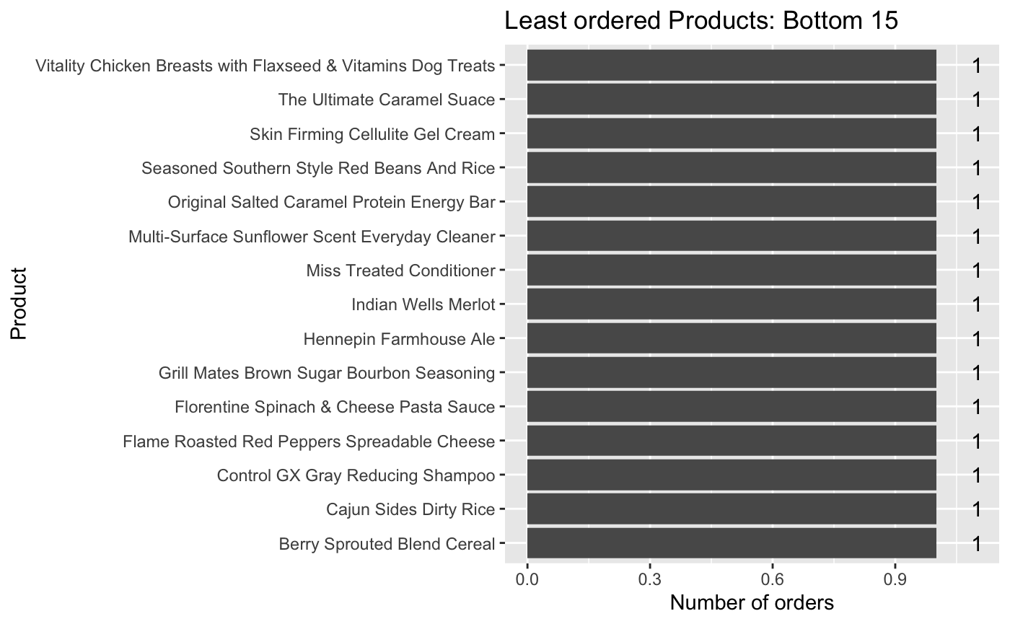
Prior Table Analysis
The graph shows the top 15 least ordered products from the prior table.
It clearly shows that the frequency of the products ordered by the customers is less.

Slide 19
Data Modeling : Model selection and Analysis
Market Basket Analysis is a modeling technique based on the logic that if you buy a certain set of products, you are more or less likely to buy another set of products.
This information can be used for the purpose like cross-selling, product placement, affinity marketing, fraud detection, and consumer behavior
Association Rule Mining is used when we want to find an association between different objects in a group, and find frequent patterns in a database or any other information repository.
We used the Apriori algorithm for mining association rules and make a comparison with the Frequent Pattern Growth Algorithm

Slide 20
Data Modeling : Model selection and Analysis
The user id and product id serve as the keys to a denormalized structure that is formed after the features are created.
We have used XGBoost ( Extreme Gradient Boosting) Classifier for the classification of the features created.
XGBoost is a scalable, distributed gradient-boosted decision tree (GBDT) machine learning library.
Supervised machine learning uses algorithms to train a model to find patterns in a dataset with labels and features and then uses the trained model to predict the labels on a new dataset’s features.

Slide 21
Metrices used to find association rules
Market Basket Analysis using Apiroi algorithms to predict grouped items, transactions, frequency, and rules and define meaning full definitions.
Apriori Algorithm: Apriori algorithm assumes that any subset of a frequent itemset must be frequent.
Association rules are created by analyzing patterns and using criteria support and confidence to identify the most crucial relationship.

Slide 22
Metrices used to find association rules
Support: Its the default popularity of an item. In mathematical terms, the support of item A is the ratio of transactions involving A to the total number of transactions.
Confidence: Likelihood that customers who bought both A and B. It is the ratio of the number of transactions involving both A and B and the number of transactions involving B.
Confidence(A => B) = Support(A, B)/Support(B)
Lift: Increase in the sale of A when you sell B.
Lift(A => B) = Confidence(A, B)/Support(B)

Slide 23
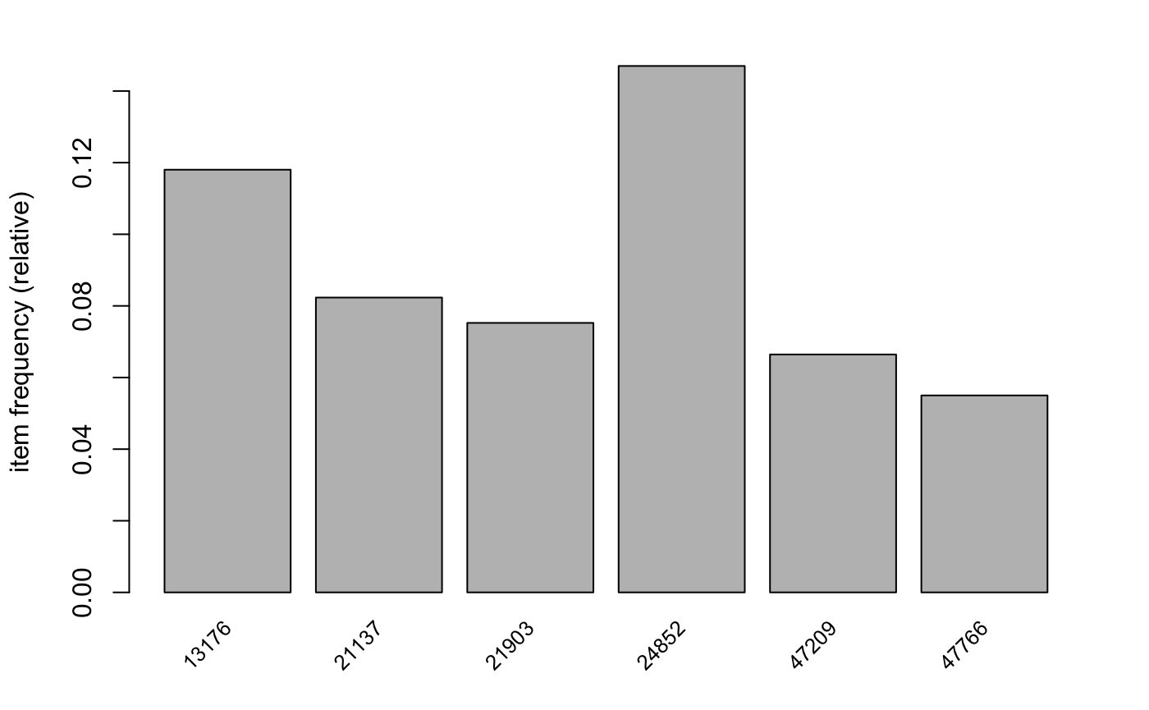
Products that occurred most frequently
Support of at least 0.05
The productsID in the x-axis indicated the most frequently brought products.

Slide 24
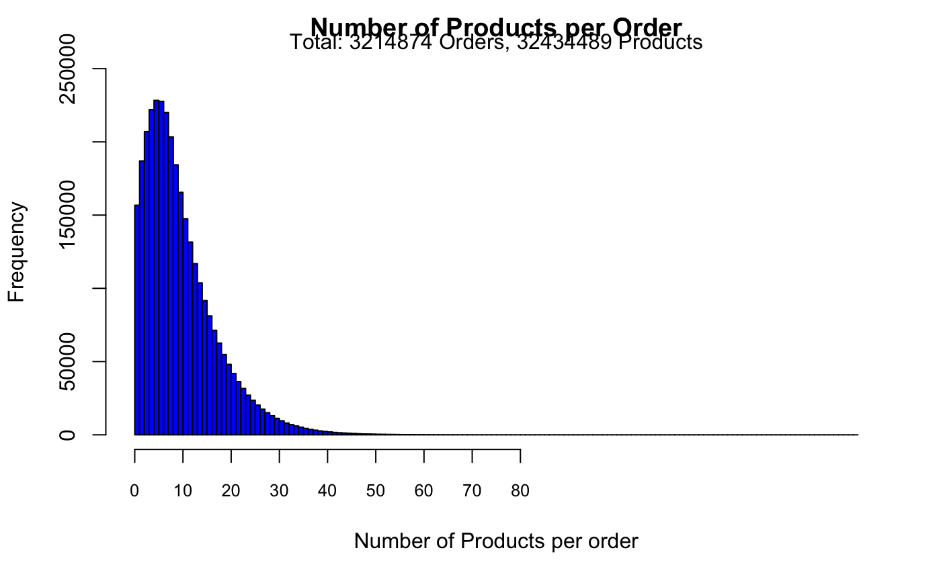
Total Product per order
Shows number of products per order
This plot shows customers usually buy around 1 to 40 products per order.

Slide 25
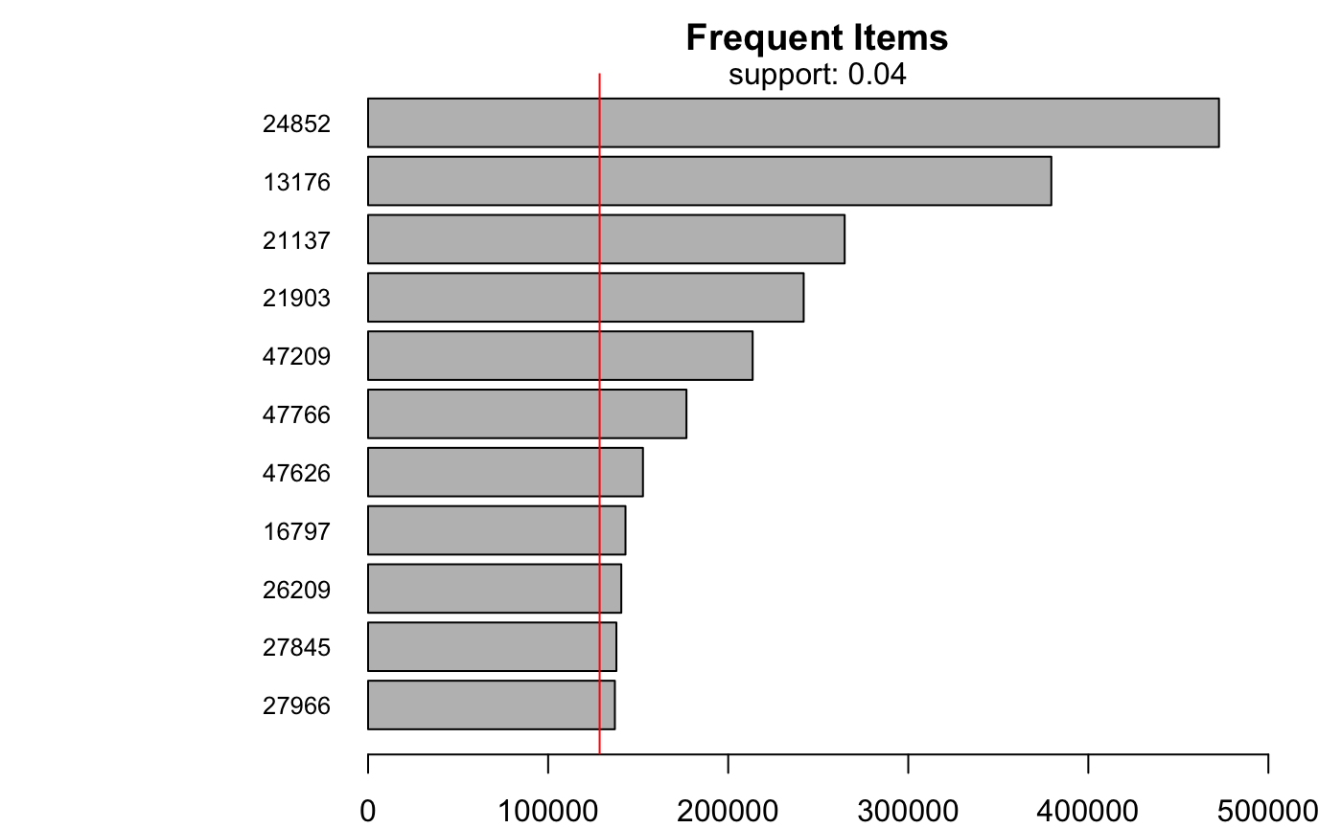
Frequent Products
Support is 0.04 which is about 4%
This plot shows there are 11 products occur when the support is set at 0.04.
This means these products are found in 4% of the total transactions which is approximately about 140k.

Slide 26
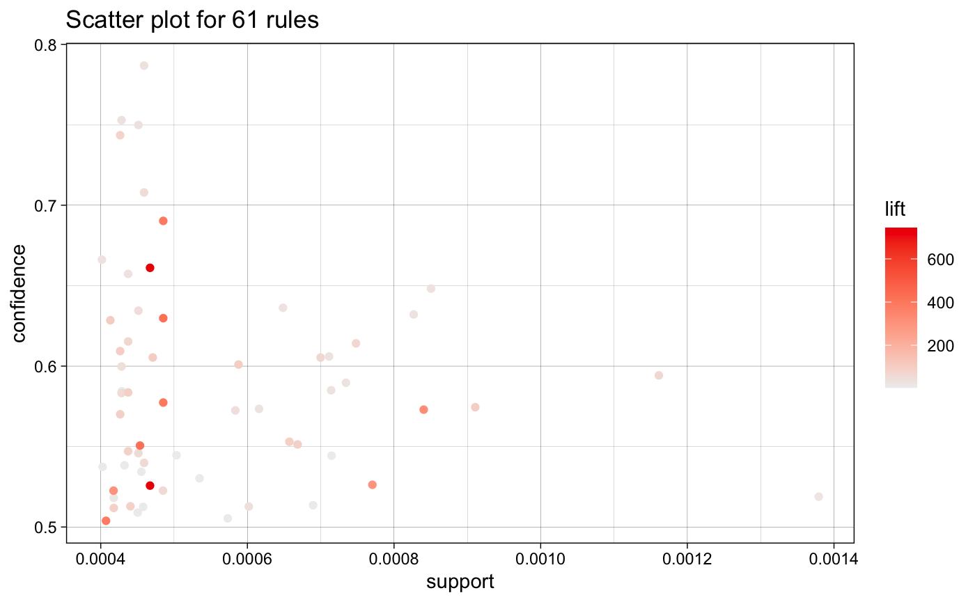
Scatter plot of rules
We found associations from the most frequent products which resulted in 11 products and can see a good lift between the confidence of 50-70% and support of 0.0004 -0.0005​
By lowering the support value of 0.0004 since we want to produce 2 items and 3 product combinations.
This means that the product gets sold 1200 times out of 3 million transactions, or around 0.04% of all transactions.

Slide 27
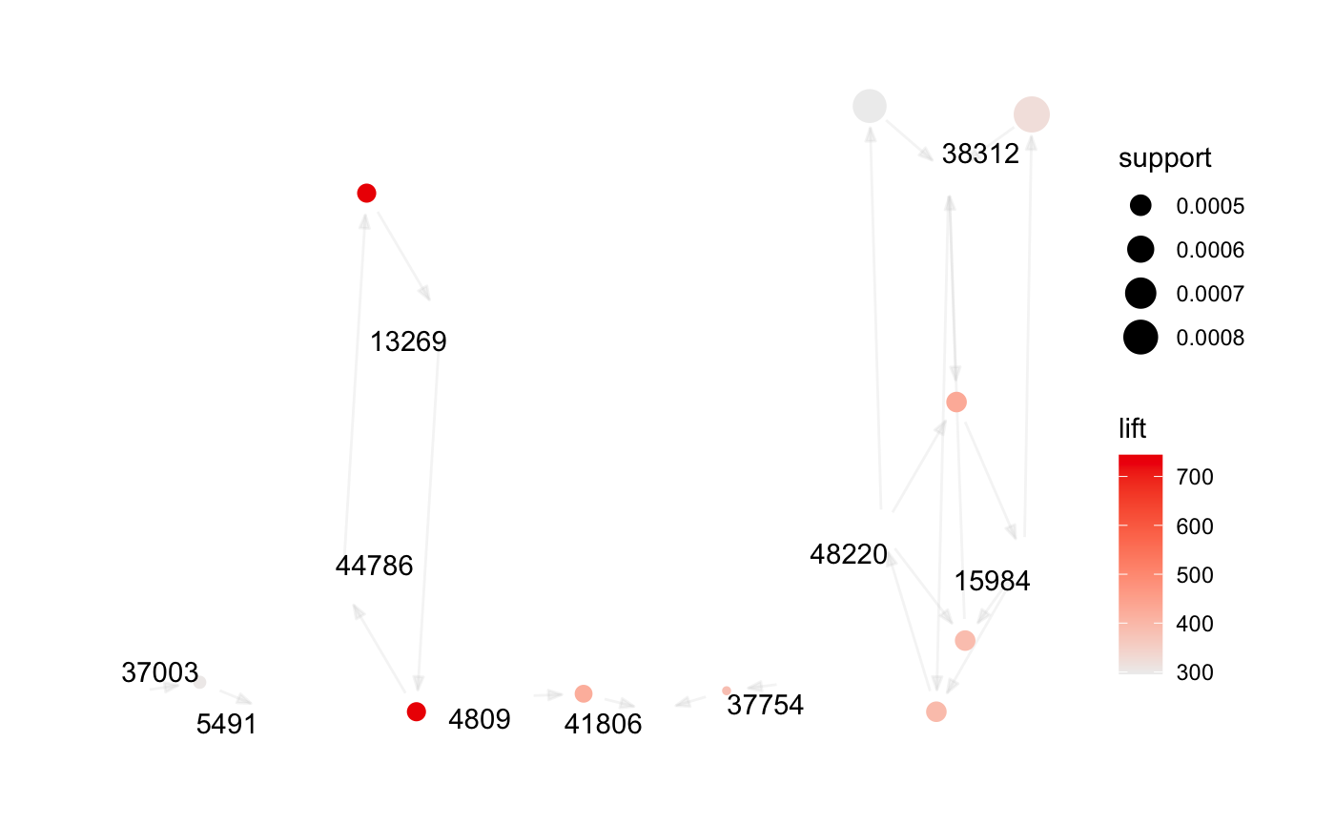
Rules and its confidence and support graph
The graph shows that ,
Product 13269 has a strong lift with product 4809

Slide 28
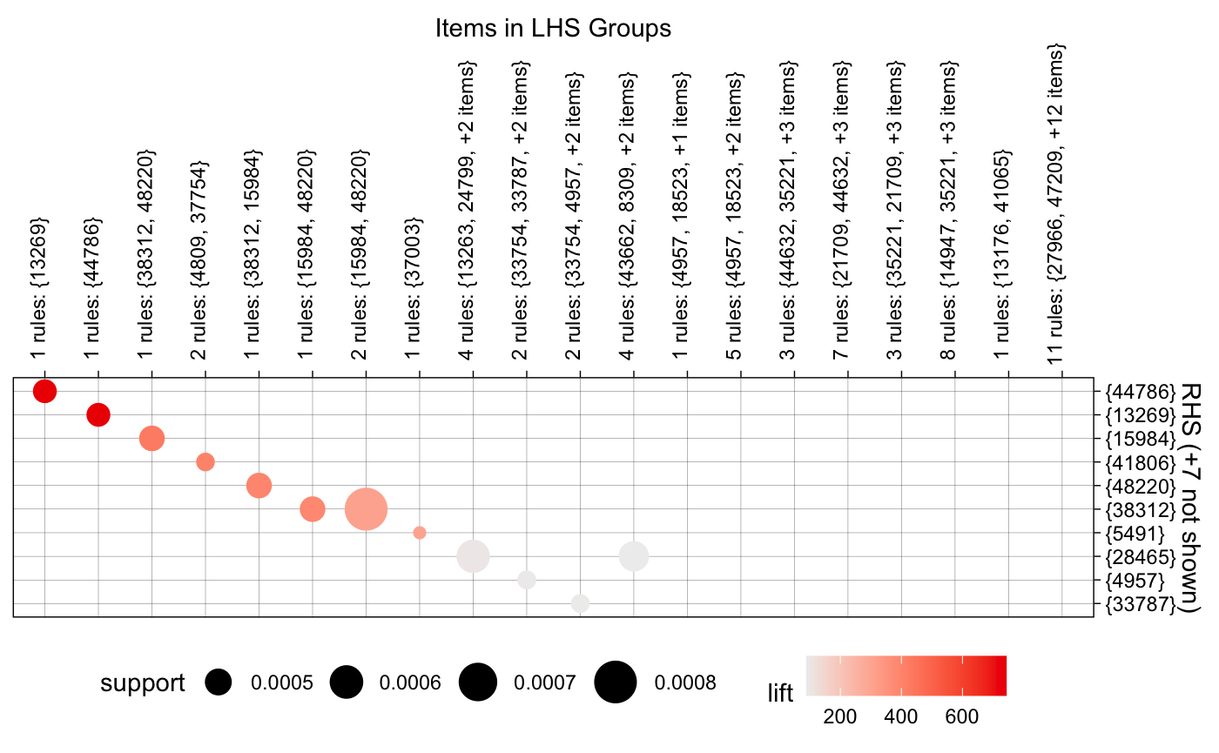
Support, Confidence and Lift of rules
Ordered by lift value, shows the effectiveness of the rule, and creates product combinations as a result
Confidence is set at 50%
A list of 61 rules is provided.

Slide 29
ML Model for Prediction next order
We used XGBoost Classifier for the prediction
we used Product and User metrics to make our prediction
We used combination metrics Group by user_id and product_id to perform our classification
Product metrics grouped by product ID | User metrics grouped by User ID
Total Orders | Total Orders
Total Order ratio for each product | Mean day of the week
Mean of add to cart | Mean hour of the day
Total times the product was reordered. | Mean day of the week and hour of the day
 | Days since the prior order
Classification Metrices
1 | Total orders
2 | Mean add to cart
3 | Total reorders

Slide 30
Hyper Parameters Matrix
Combination metrics and scores are converted into a matrix
we split the data to test and train and then performed the training of the model with these hyperparameters.
The model is used to predict the next orders where if the product is ordered (a probability greater than 21%) then we consider that product is reordered in a particular order.
eta | 0.1
max_depth | 6
min_child_weight | 10
gamma | 0.7
subsample | 0.77
colsample_bytree | 0.95
alpha | 0.00002
lambda | 10

Slide 31
Final Evaluation
Accuracy would not be the right measure to evaluate the model due to an imbalanced data set.
we achieved the F1 score and obtained a score of 0.404.

Slide 32
Conclusion
By employing the results of the association analysis and XGBoost classifier model, we can predict the products that would be brought by the user in near future.
By using these analytics, the company could perform curated results and thus increase the business revenue.
Rules are refined based on Confidence, support, and lift metrics and combinations
Notes:
May

Slide 33
Future Work
Further, improve of the F1 score
Identify other methods to handle imbalanced data sets, which include hyperparameter tuning and other supervised classification models
Includes prediction based on neural nets, deep learning, and using different metrics to predict the next buy.
Also, Collaborative filtering can be used to suggest products to customers
Notes:
May

Slide 34
References
Fachrul Kurniawan, Binti Umayah, Jihad Hammad, Supeno Mardi Susiki Nugroho and Mochammad Hariadi, “Market Basket Analysis to Identify Customer Behaviors by Way of Transaction Data” Knowledge Engineering and Data Science (KEDS) -Vol 1, No 1, January 2018, pp. 20–25
Manpreet Kaur ,Shivani Kang. “Market Basket Analysis: Identify the changing trends of market data using association rule mining”, International Conference on Computational Modeling and Security (CMS 2016), Procedia Computer Science 85 (2016) 78 – 85
A. Herman, L.E. Forcum, Joo Harry. Using Market Basket Analysis in Management Research, Journal of Management, 39 (7) (2013), pp. 1799-1824
Market Basket Analysis - an overview | ScienceDirect Topics
Association Rules in Data Mining | Learn the Algorithms, Types, and Uses (educba.com)
Data Extraction | Data Cleaning| Intellipaat
What Is Data Analysis? Methods, Techniques, Types & How-To
Exploratory Data Analysis: Useful Python Functions for Exploring a Data Frame | Kaggle
Beginner’s Guide to XGBoost for Classification Problems | Towards Data Science

Slide 35
Q&A
Thanks!

